Slide 1

Fuel Cell
Hoang Khang Le – 98083
Supervisor1: Prof. Dr.-Ing Karsten Pinkwart
Supervisor2: Dr. Margarita Aleksandrova

Slide 2
Content
Introduction
Theoretical
Experiment
Result
Conclusion
Reference

Slide 3
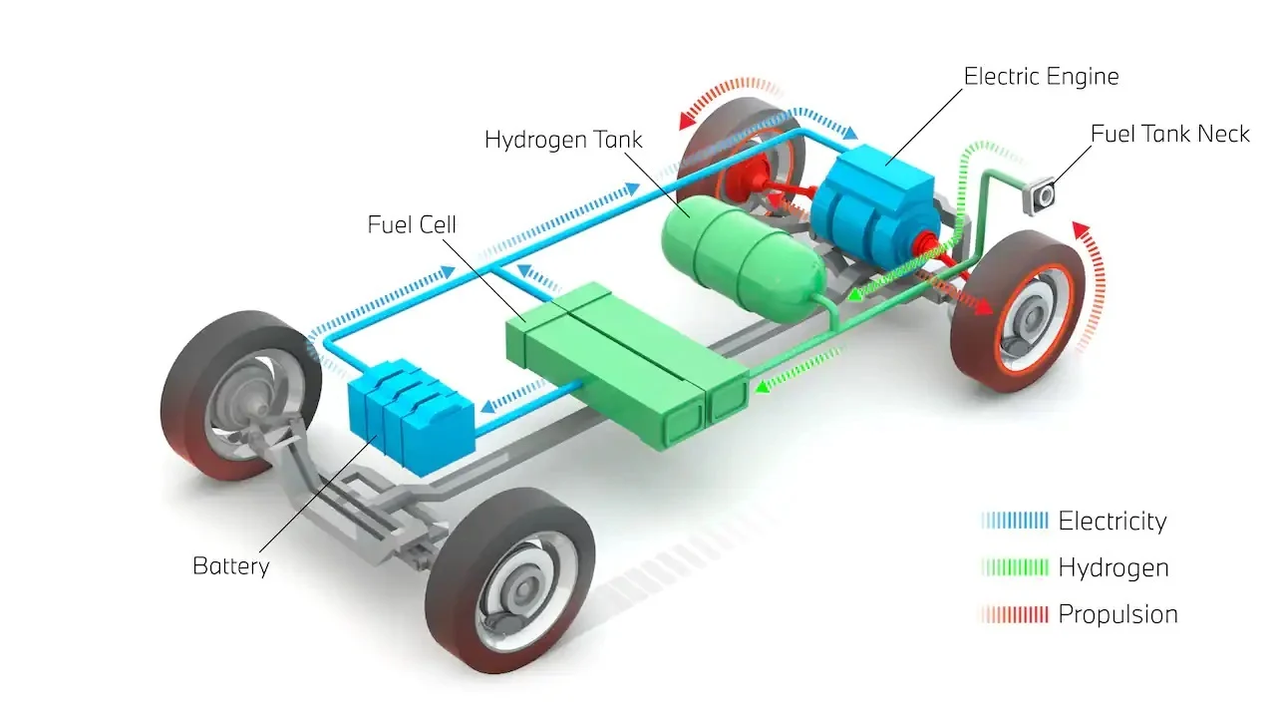
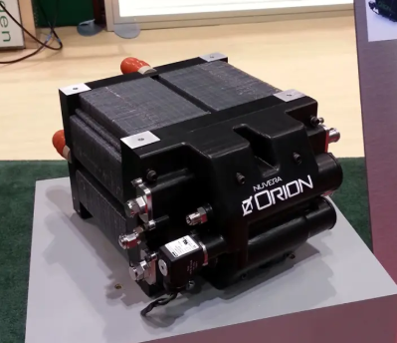
Introduction
Proton Exchange Membrane Fuel Cell
Scheme of fuel cell electric vehicle
https://fchea.org
https://uk.pcmag.com/
Notes:
Due to global warming and its increasing impact on weather patterns, especially in tropical regions, there is a growing need for clean and renewable energy sources. Additionally, the Russia-Ukraine war has disrupted the global energy supply, limited the availability of natural fuels and driven the energy market toward alternatives like electric vehicles (EVs). Companies such as Tesla and innovators like Elon Musk have accelerated investments in this sector, further increasing the importance of sustainable energy solutions.
Among these, fuel cells have emerged as a promising technology. Fuel Cell Electric Vehicles (FCEVs) are now being researched and applied as a viable alternative due to their adaptability and high-power density, which make them suitable for various applications in clean transportation.
In this project, experiments are conducted on a fuel cell system to analyze its characteristics, performance, and potential phenomena during operation. The findings are connected to theoretical knowledge from lectures, enabling a comprehensive understanding of fuel cell systems and their real-world applications.

Slide 4
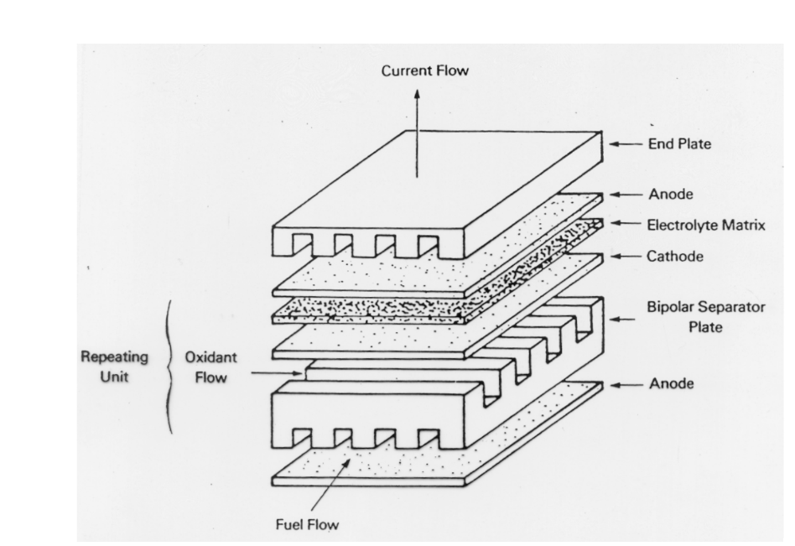
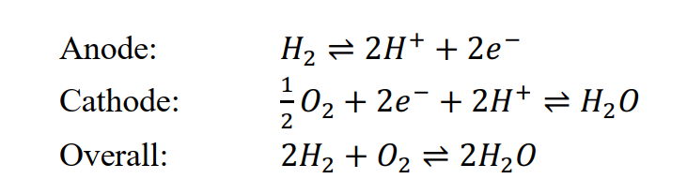
Theory - Structure of the fuel cell
Fuel Cell – [3]
Fuel Cell Structure
Karsten, P. (2024) Electrochemical storage system
Notes:
5 main layers:
Anode: Facilitates fuel oxidation, splitting hydrogen into protons and electrons. Made of porous carbon with a catalyst (e.g., platinum).
Cathode: Supports the reduction reaction where oxygen combines with protons and electrons to form water. Also made of porous carbon with a catalyst.
Electrolyte: A proton-conducting layer that allows only protons to pass while blocking electrons. It separates the anode and cathode.
Gas Diffusion Layers (GDLs): Thin, porous layers that ensure uniform gas distribution and manage water and heat transport.
Bipolar Plates: Provide structural support, distribute reactant gases, and conduct electrons between cells in a stack.
End Plates: Secure the fuel cell stack and prevent gas leaks.
Flow Field Channels: Deliver hydrogen and oxygen, while removing water and heat, ensuring efficient operation.

Slide 5

Experiments

Slide 6
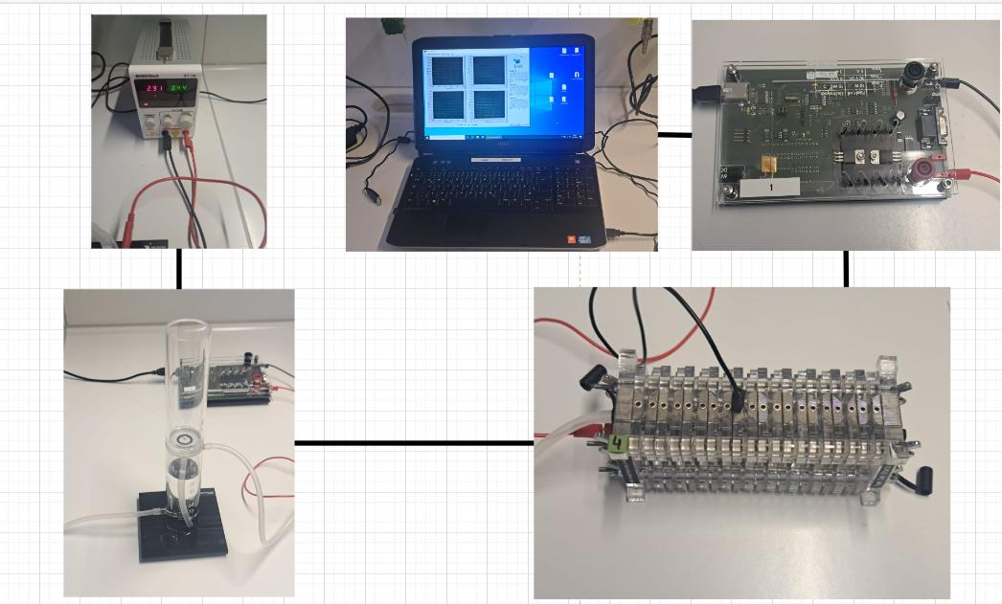
Characteristic curve of hydrogen Fuel Cell
Aim:
Build a characteristic curve of a hydrogen PEMFC
The Experiment Set Up
Notes:
Four cells from the lab's fuel cell system are utilized to examine the fuel cell’s characteristic curve.
To collect and store data on voltage, current, and power, a measurement device and a computer are connected to the fuel cell system.
A hydrogen generator, powered by a 4.5V supply, serves as the fuel source.
This generator separates hydrogen from water, supplying hydrogen directly to the fuel cell system.
Once the hydrogen is supplied, the measurement device simulates the load and captures data to generate the characteristic curve.
The collected data is displayed on the computer and stored in a text format for further analysis. Noted that in the app on the computer lab, the mode “Automatic” is chose.

Slide 7
Voltage controlled measurements
Aim:
Maintain the voltage – load at a consistent value, therefore, the data of current and power over time are collected.
The Experiment Set Up
Notes:
Using the same set up as previous experiment, but in this case, we choose mode “voltage constant” in the computer app

Slide 8
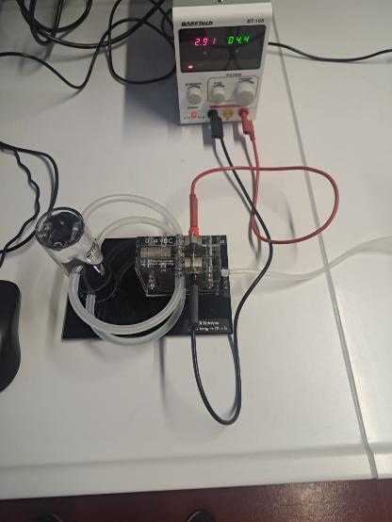
Determination of efficiency
Aims:
Measure the volume of hydrogen produced over time and use the collected data, along with data from Experiment 1
Calculate the efficiency and energy efficiency of the fuel cell system.
The Experiment Set Up

Slide 9
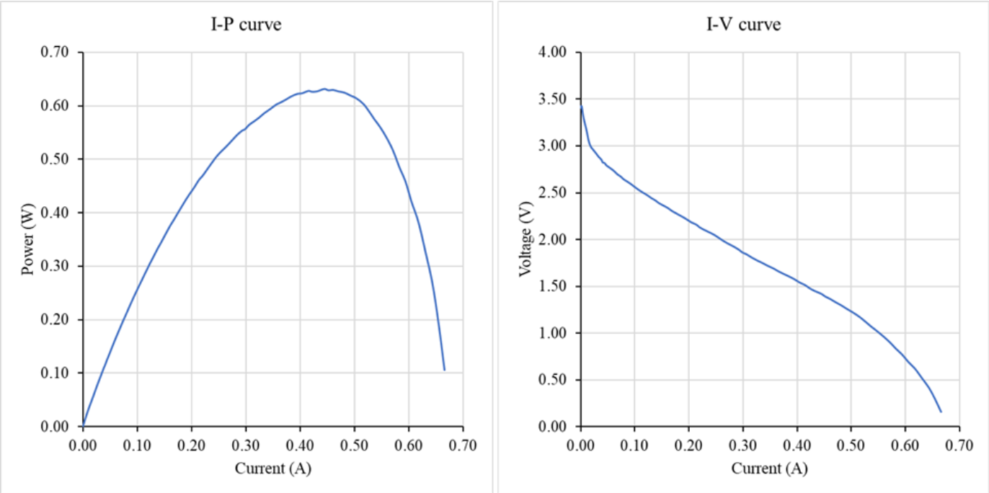
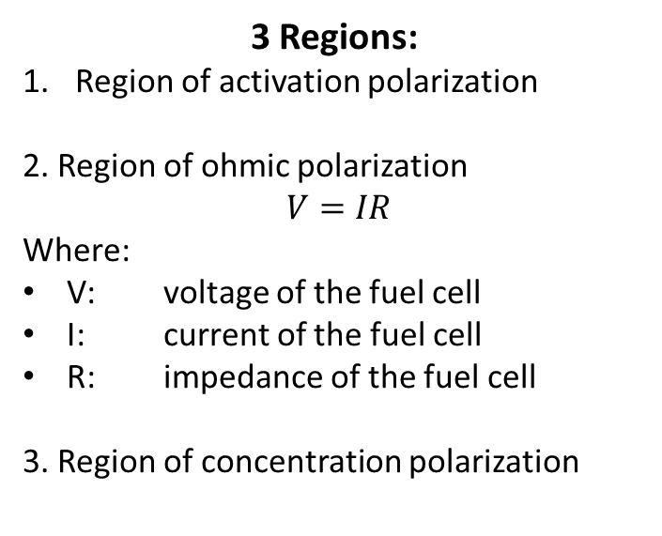
Result - Characteristic curve of hydrogen Fuel Cell 1st
3 Regions:
Region of activation polarization
2. Region of ohmic polarization
$V=IR$
Where:
V: voltage of the fuel cell
I: current of the fuel cell
R: impedance of the fuel cell
3. Region of concentration polarization
1
2
3
1
2
3
Characteristic curve of hydrogen Fuel Cell – 1st measurement

Slide 10
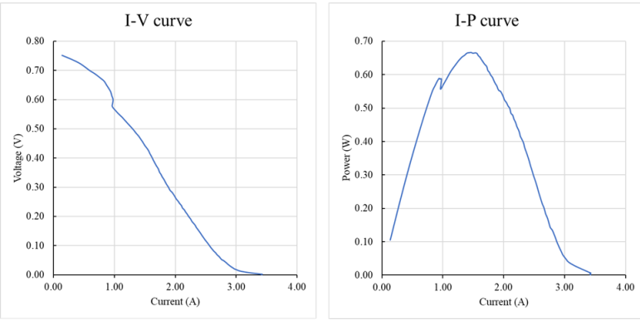
Result - Characteristic curve of hydrogen Fuel Cell 2nd
Special phenomenon:
One of the fuel cell stops working because bypass product blocks the ion transfer.
Characteristic curve of hydrogen Fuel Cell – 1st measurement

Slide 11
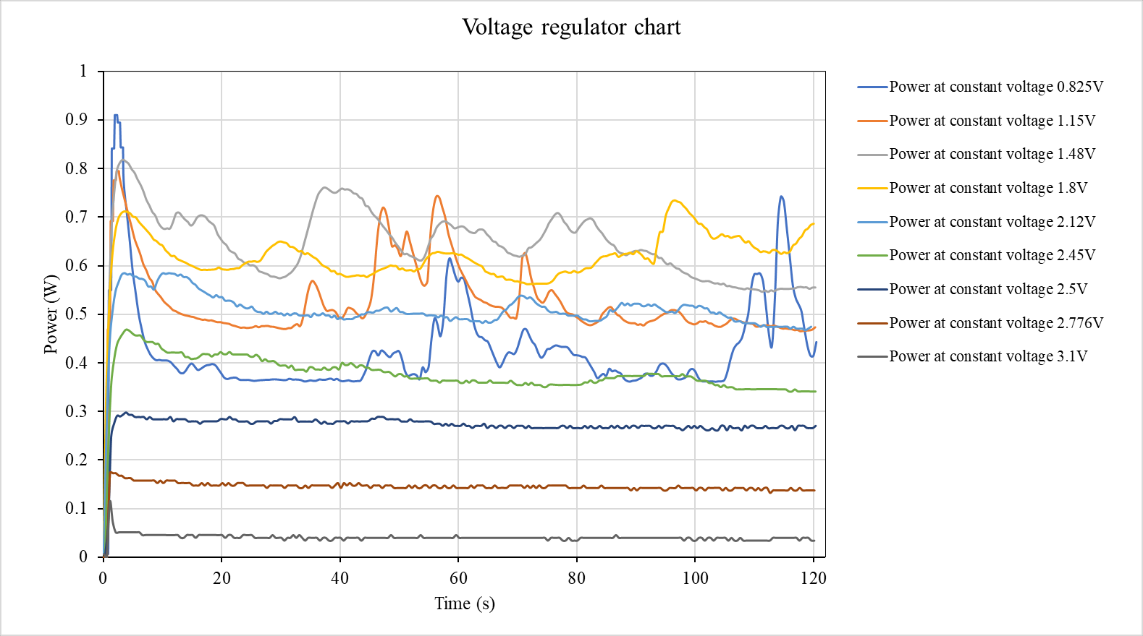
Voltage controlled measurements
Has the most power created by FC
Belong to the ohmic polarization

Slide 12
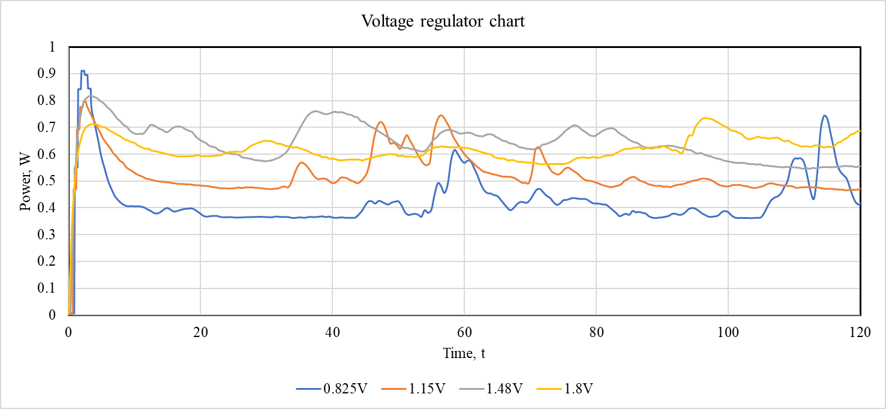
Voltage controlled measurements
Fluctuation
Notes:
Water is a by-product of the fuel cell reaction. Accumulation of water (flooding) at the electrodes can temporarily block the flow of reactants (hydrogen or oxygen) to the catalyst sites, reducing efficiency. When water clears, a spike in power may occur as reactant flow resumes.
Conversely, insufficient water can lead to membrane dehydration, reducing ionic conductivity, which could also cause temporary fluctuations.

Slide 13
Voltage controlled measurements
Cannot overcome the initialthe electrochemical reaction barriers at the electrodes

Slide 14
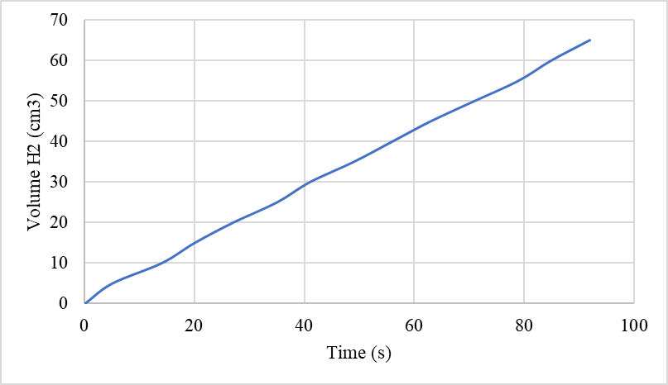
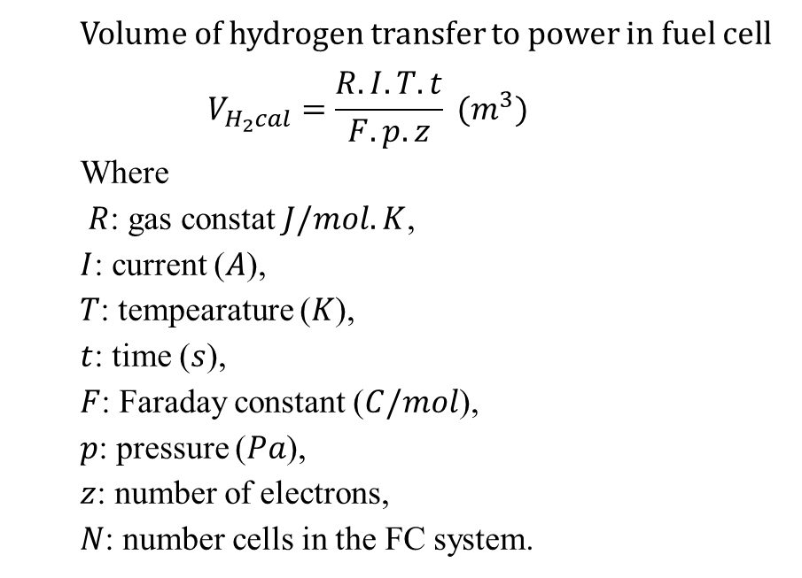
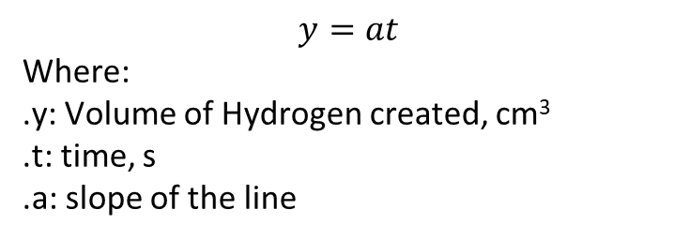
Determination of efficiency
Volume of the hydrogen produced by the fuel generator
Volume of hydrogen transfer to power in fuel cell
$$V_{H_{2}cal}=\frac{R.I.T.t}{F.p.z} (m^{3})$$
Where
$R$: gas constat$J/mol.K$,
$I$: current ($A$),
$T$: tempearature ($K$),
$t$: time ($s$),
$F$: Faraday constant ($C/mol$),
$p$: pressure ($Pa$),
$z$: number of electrons,
$N$: number cells in the FC system.
$$y=at$$
Where:
.y: Volume of Hydrogen created, cm³
.t: time, s
.a: slope of the line

Slide 15
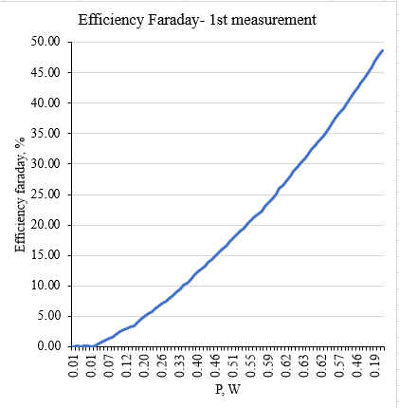
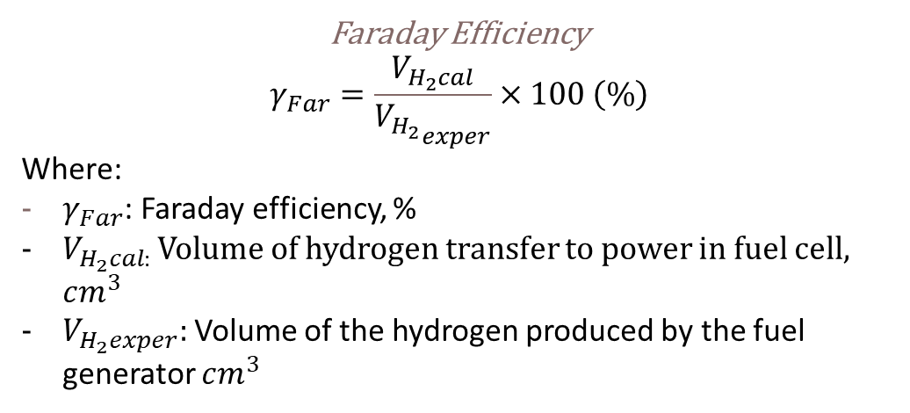
Determination of efficiency
Faraday Efficiency
$$γ_{Far}=\frac{V_{H_{2}cal}}{{V_{H_{2}}}_{exper}}×100 \left(\%\right)$$
Where:
$γ_{Far}$: Faraday efficiency, %
$V_{H_{2}cal: }$Volume of hydrogen transfer to power in fuel cell, $cm^{3}$
$V_{H_{2}exper}:$Volume of the hydrogen produced by the fuel generator $cm^{3}$

Slide 16
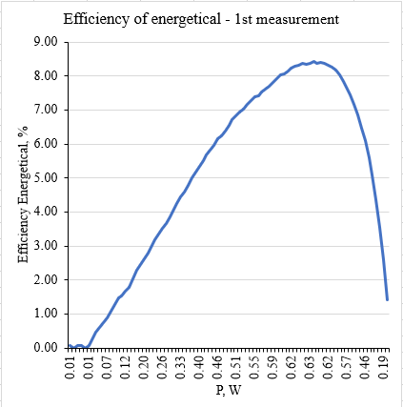
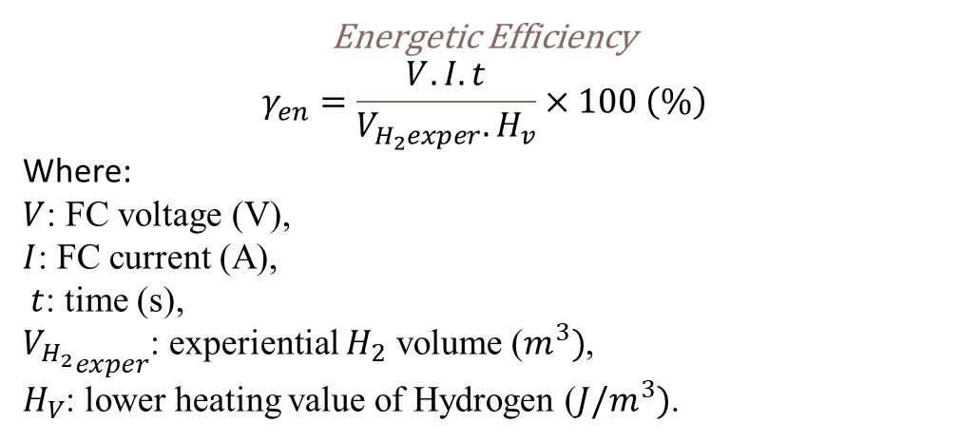
Determination of efficiency
Energetic Efficiency
$$γ_{en}=\frac{V.I.t}{V_{H_{2}exper}. H_{v}}×100 \left(\%\right)$$
Where:
$V$: FC voltage (V),
$I$: FC current (A),
$t$: time (s),
${V_{H_{2}}}_{exper}$: experiential $H_{2}$ volume ($m^{3})$,
$H_{V}$: lower heating value of Hydrogen ($J/m^{3})$.

Slide 17
Conclusion
Understand the structure and basic working principle of the PEM fuel cell.
Understand the characteristic I-V curve and efficiency of PEM fuel cell
Understand the behavior of the fuel cell under various condition.

Slide 18
Reference
1. https://fchea.org/learning-center/fuel-cell-basics/
2. https://uk.pcmag.com/cars-auto/141086/hydrogen-powered-cars-fuel-cell-electric-vehicles-explained
3. Karsten, P. (2024) Electrochemical storage system. Electrochemical storage system, Karlsruhe: Hochschule Karlsruhe, 7 October
4. LARMINIE, J. (2018) Fuel Cell Systems explained. JOHN WILEY.

Slide 19
Thank you for listening

Slide 20
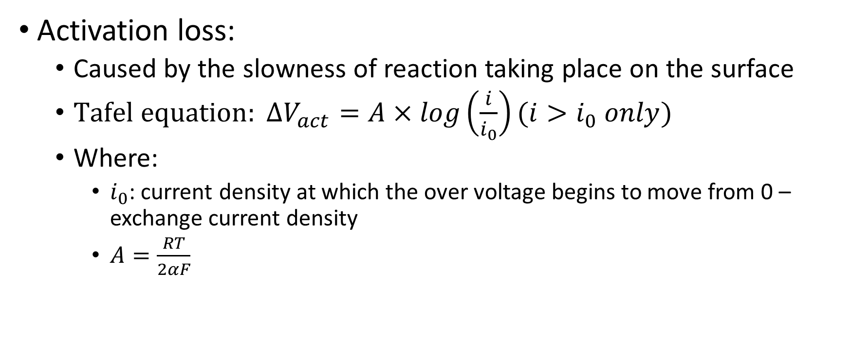
Appendix
Activation loss:
Caused by the slowness of reaction taking place on the surface
$Tafel equation: ΔV_{act}=A×log\left(\frac{i}{i_{0}}\right)(i>i_{0} only)$
Where:
$i_{0}$: current density at which the over voltage begins to move from 0 – exchange current density
$A=\frac{RT}{2αF}$

Slide 21
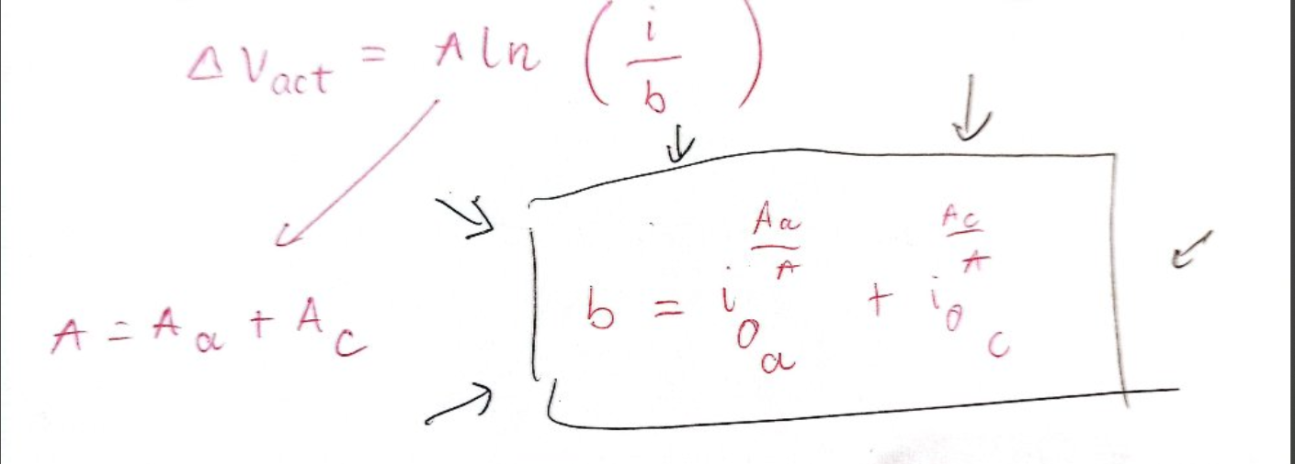
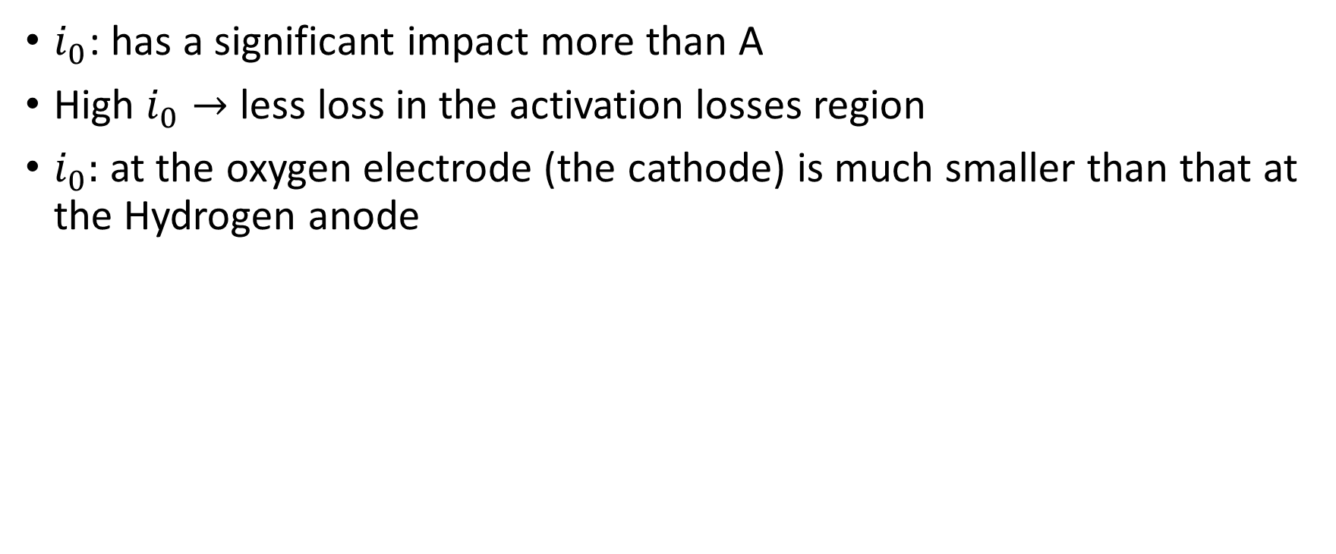
Activation loss
$i_{0}$: has a significant impact more than A
High $i_{0}→$ less loss in the activation losses region
$i_{0}:$ at the oxygen electrode (the cathode) is much smaller than that at the Hydrogen anode

Slide 22
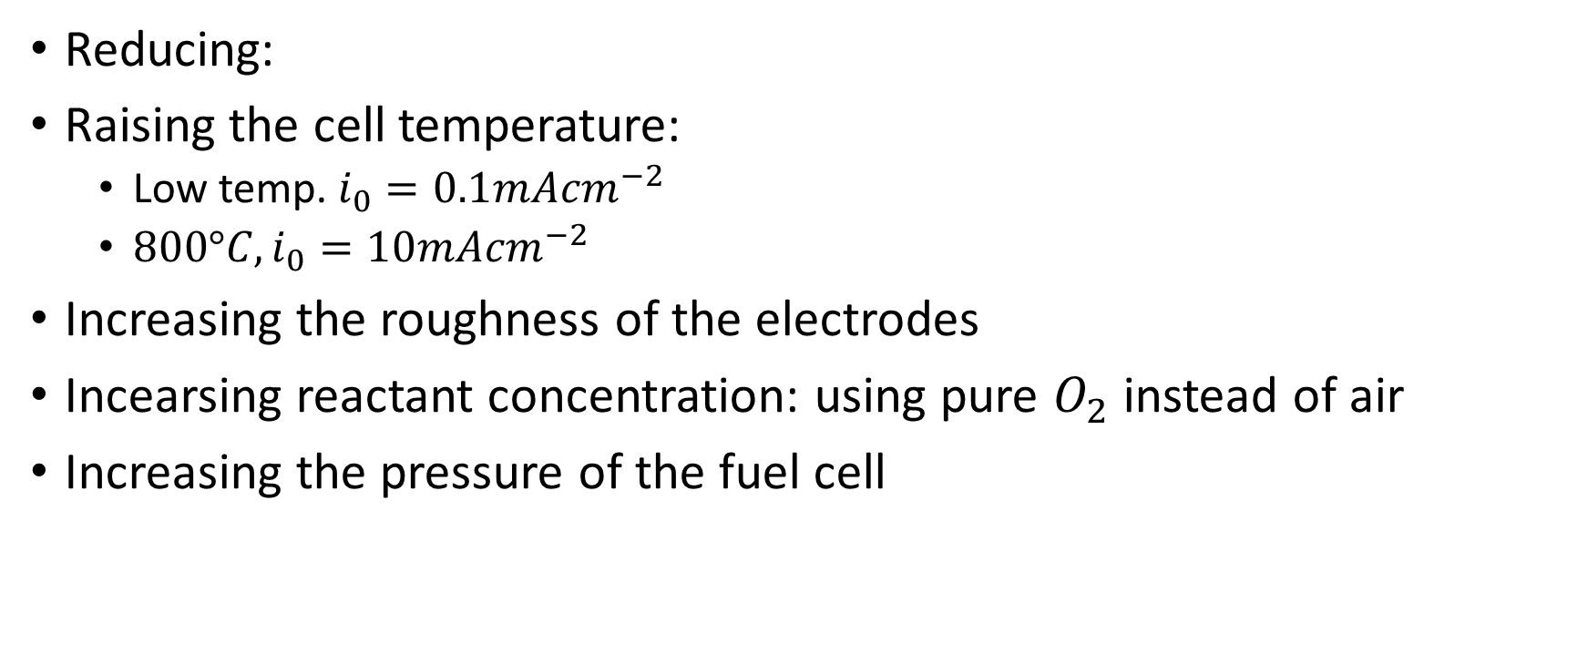
Actovation loss
Reducing:
Raising the cell temperature:
Low temp. $i_{0}=0.1mAcm^{−2}$
$800°C, i_{0}=10mAcm^{−2}$
Increasing the roughness of the electrodes
Incearsing reactant concentration: using pure $O_{2}$ instead of air
Increasing the pressure of the fuel cell

Slide 23
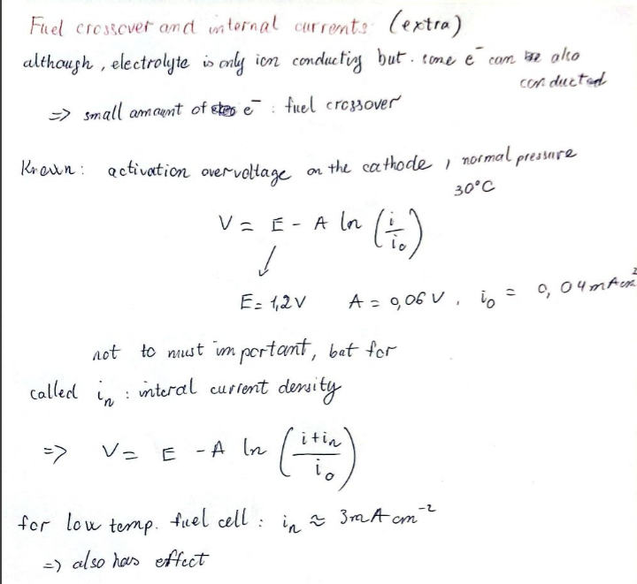
Fuel Cell and Internal Currents

Slide 24
Ohmic losser
Resistance caused by the electrolyte, the cell interconnections or bipolar
Reducing the internal resistance:
Use of electrode with the highest possible conductivity
Good design and use approx. material for the bipolar plates or all interconnection
Making electrolyte as thin as possible

Slide 25
Mass transport or Concentration losses
A reduction in the concentration of the oxygen

Slide 26
Application
transportation primarily because of their potential impact on the environment, e.g. the control of emission of the green house gases (GHG).
distributed/stationary and portable power generation.

Slide 27
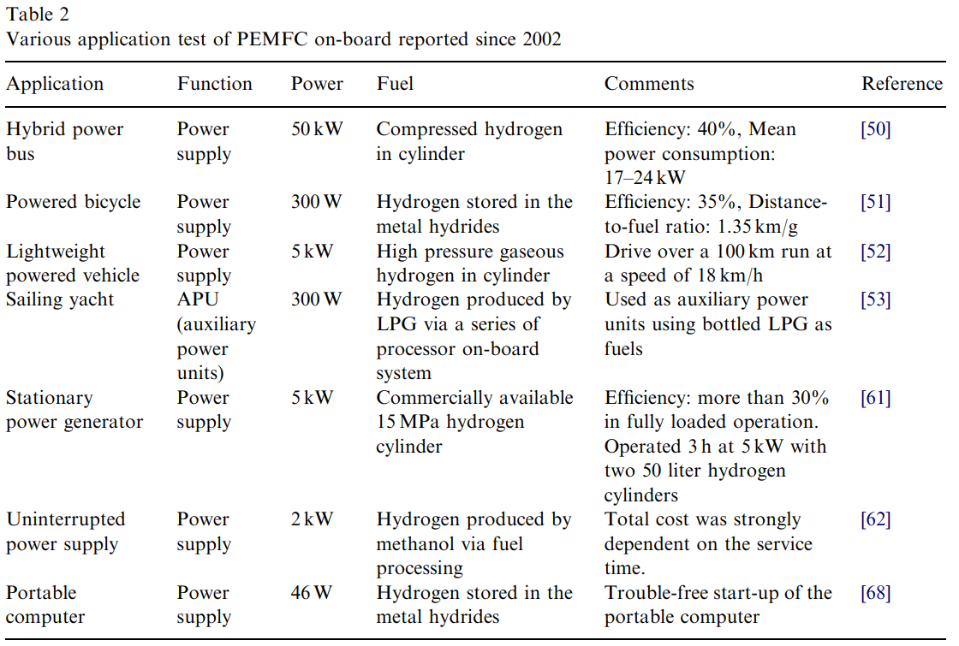
Jung-Ho Wee, Applications of proton exchange membrane fuel cell systems, Renewable and Sustainable Energy Reviews, Volume 11, Issue 8, 2007, Pages 1720-1738, ISSN 1364-0321, https://doi.org/10.1016/j.rser.2006.01.005.

Slide 28

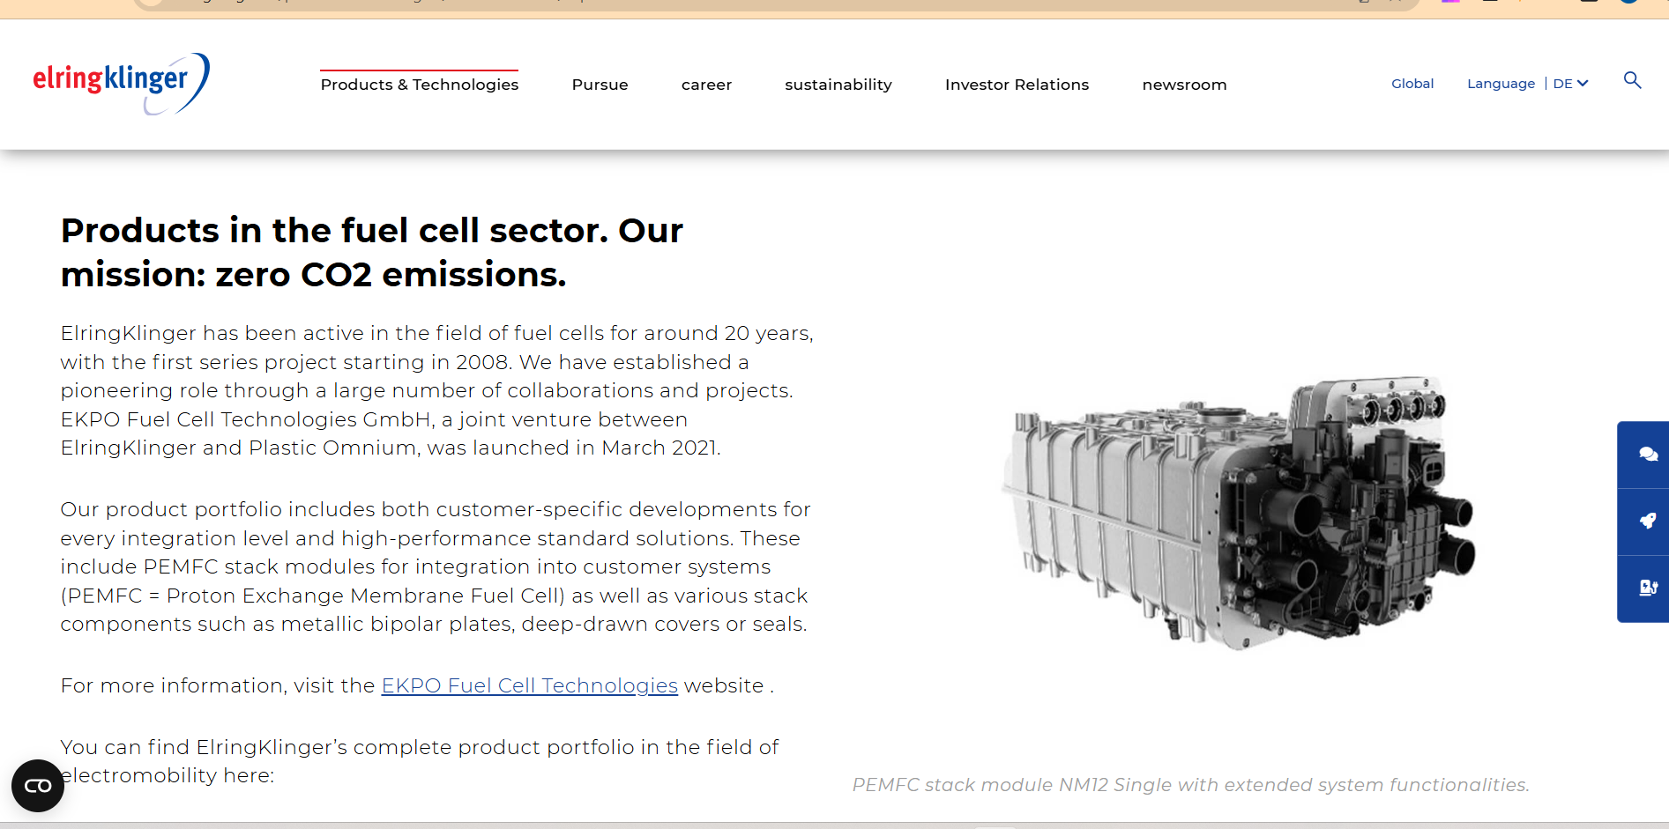
Market - Provider
https://www.ballard.com/
https://elringklinger.de/produkte-technologien/brennstoffzellen/ekpo

